Slide 1
Second-generation p-values: equivalence tests, statistical properties, and false discovery rates
Part II
Jeffrey D. Blume,
PhD
Megan H. Murray, almost PhD (July 6th defense)
and
School of Data Science
University of Virginia
Department of Biostatistics
Vanderbilt University

Slide 2
Timeline
Slides Part I
Introduction and applications
Coding Part I
Slides Part II
Equivalence tests, statistical properties, and false discovery rates
Coding Part II
Questions and Discussion

Slide 3
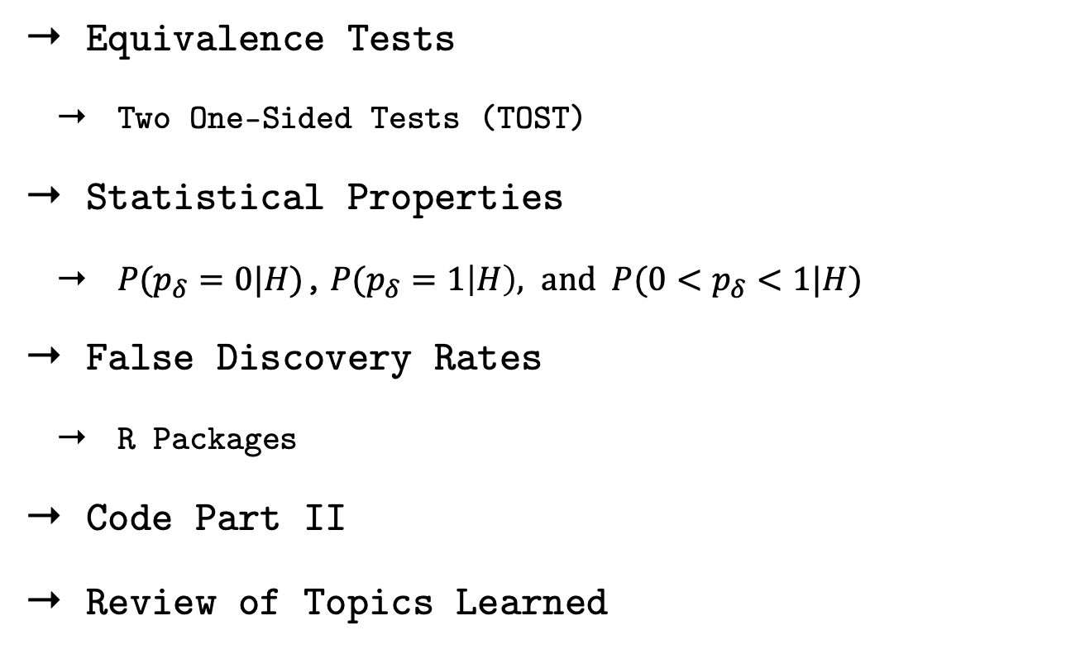
Outline
Equivalence Tests
Two One-Sided Tests (TOST)
Statistical Properties
${P(p}_{δ}=0|H)$,${P(p}_{δ}=1\left|H\right), and {P(0<p}_{δ}<1|H)$
False Discovery Rates
R Packages
Code Part II
Review of Topics Learned

Slide 4
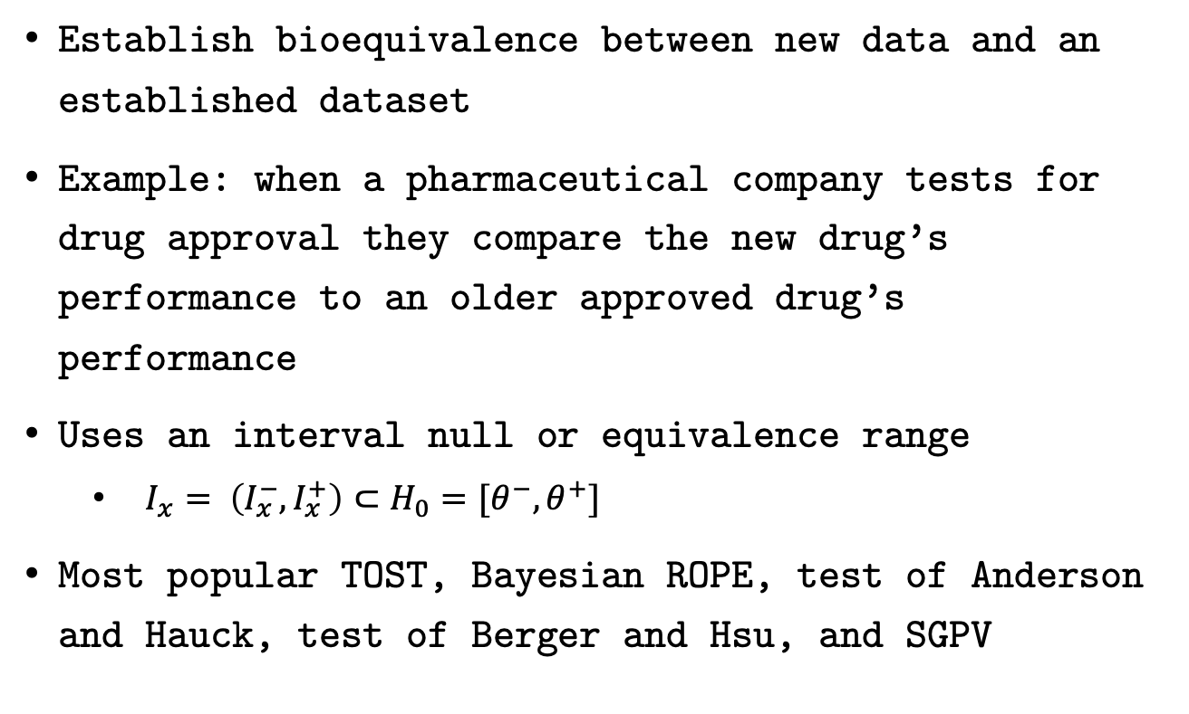
Equivalence Tests
Establish bioequivalence between new data and an established dataset
Example: when a pharmaceutical company tests for drug approval they compare the new drug’s performance to an older approved drug’s performance
Uses an interval null or equivalence range
$I_{x}= \left(I_{x}^{−}, I_{x}^{+}\right)⊂H_{0}=[θ^{−}, θ^{+}]$
Most popular TOST, Bayesian ROPE, test of Anderson and Hauck, test of Berger and Hsu, and SGPV

Slide 5
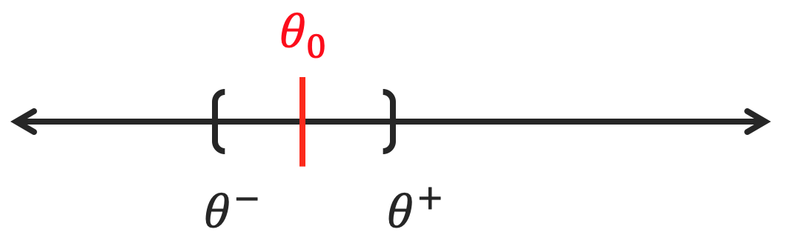
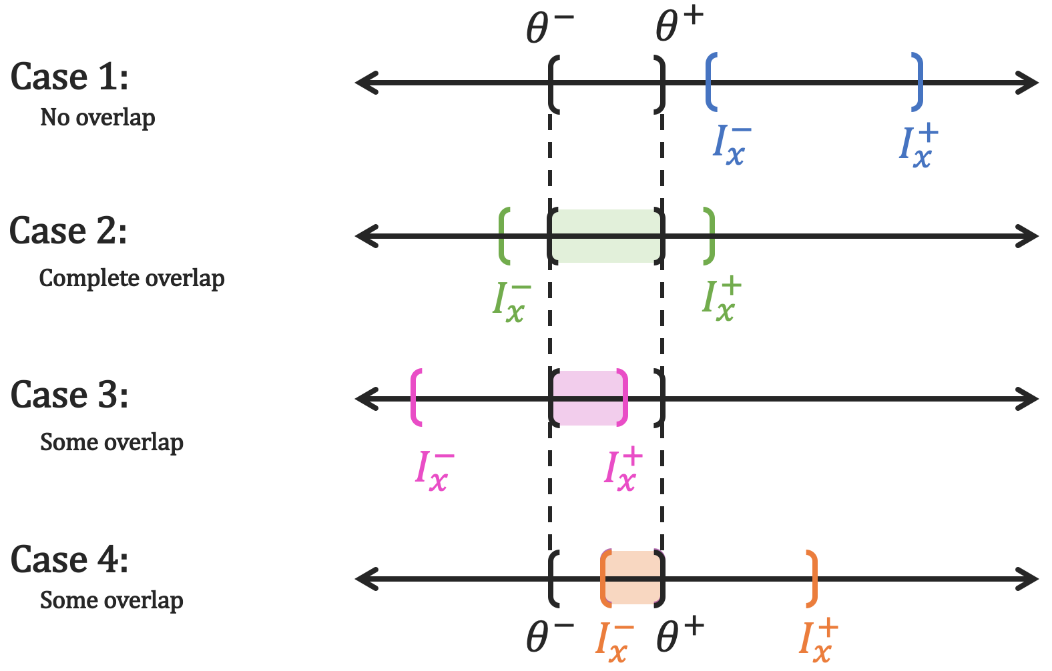
Equivalence Tests

Slide 6
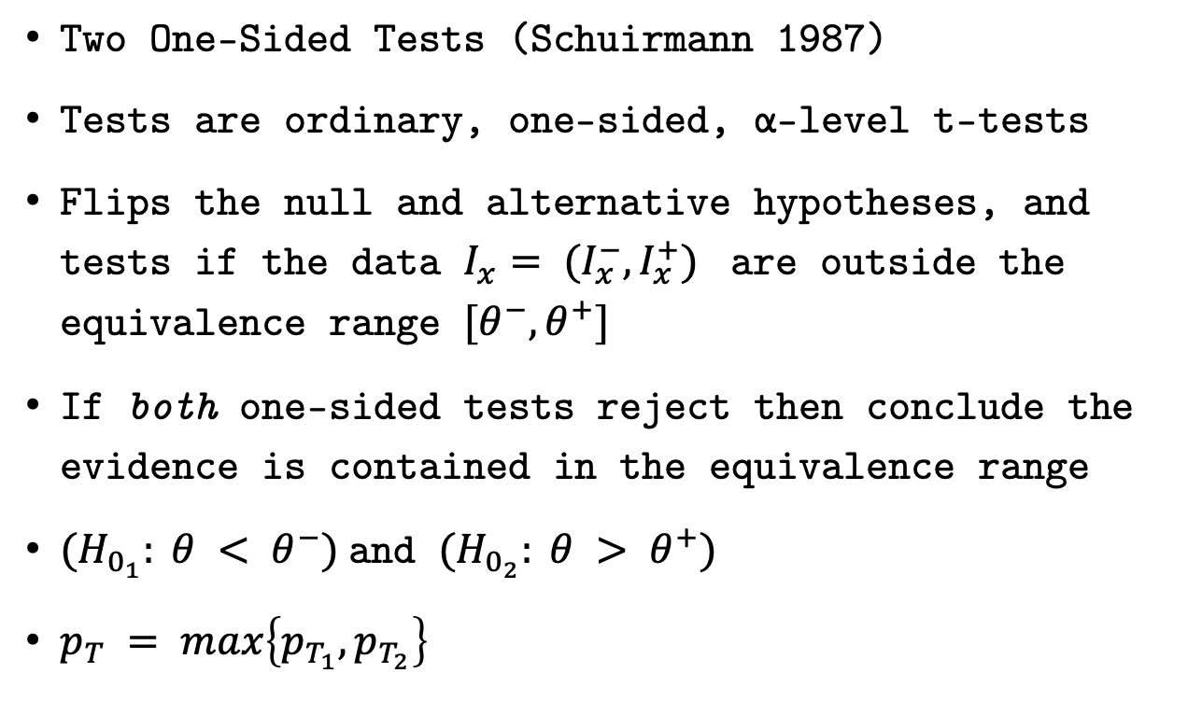
TOST Test
Two One-Sided Tests (Schuirmann 1987)
Tests are ordinary, one-sided, α-level t-tests
Flips the null and alternative hypotheses, and tests if the data $I_{x}= (I_{x}^{−}, I_{x}^{+})$ are outside the equivalence range $[θ^{−}, θ^{+}]$
If both one-sided tests reject then conclude the evidence is contained in the equivalence range
${(H}_{0_{1}}: θ < θ^{−})$and $(H_{0_{2}}: θ > θ^{+})$
$p_{T} =\max\left\{p_{T_{1}},p_{T_{2}}\right\}$

Slide 7
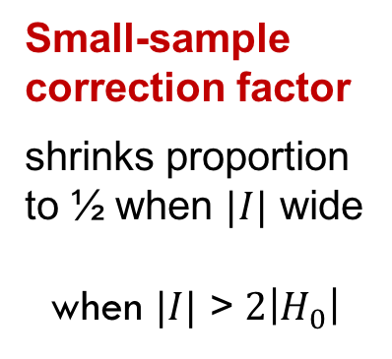
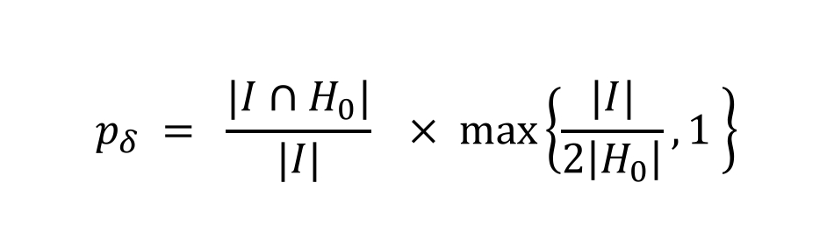
SGPV Definition
Second-generation p-value (SGPV)
$$p_{δ} = \frac{|I∩H_{0}|}{|I|}× max\left\{\frac{|I|}{2\left|H_{0}\right|},1 \right\}$$
Proportion of data-supported hypotheses that are also
null hypotheses
Small-sample correction factor
shrinks proportion to ½ when $|I|$ wide
when $|I|$ > $2\left|H_{0}\right|$

Slide 8
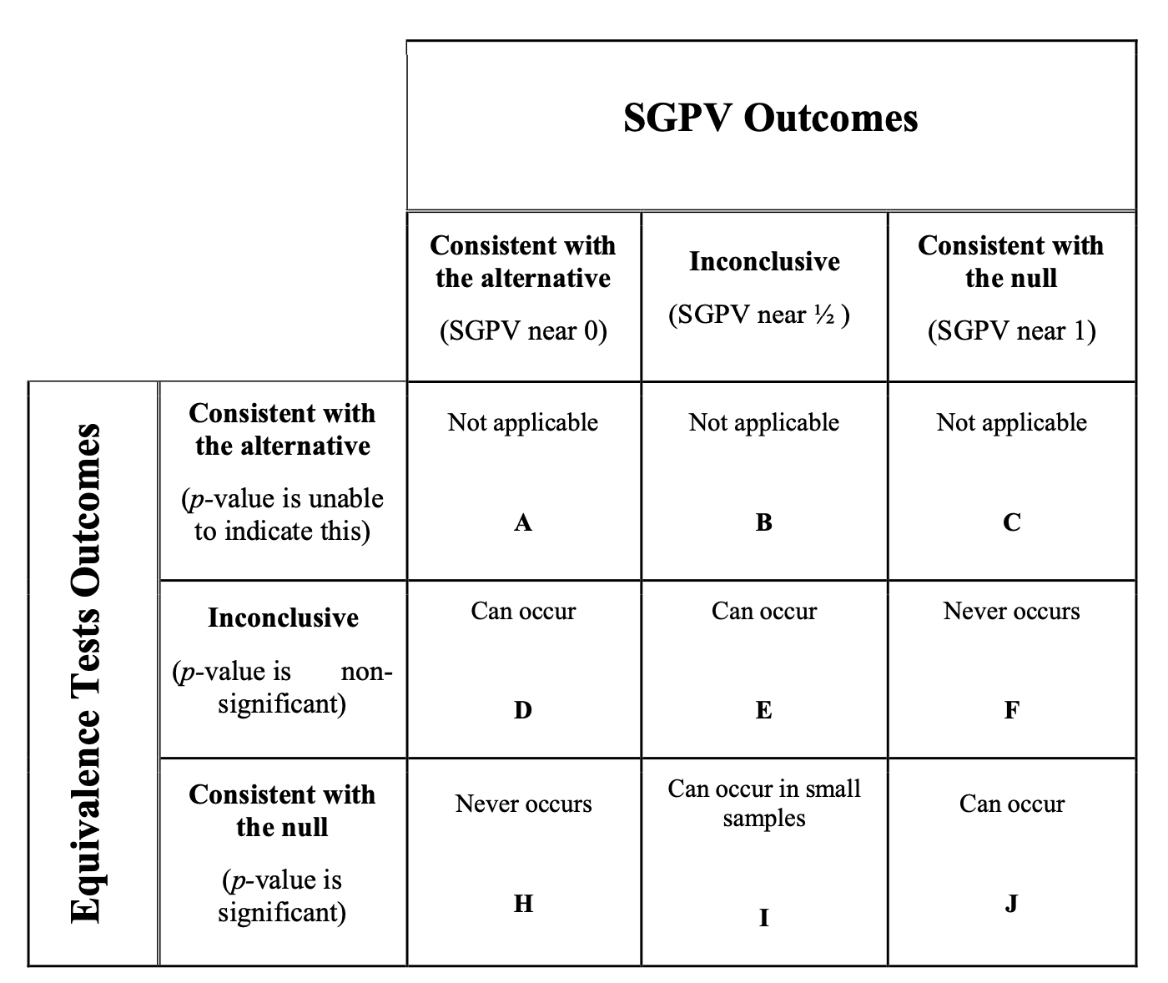
TOST vs. SGPV comparison

Slide 9
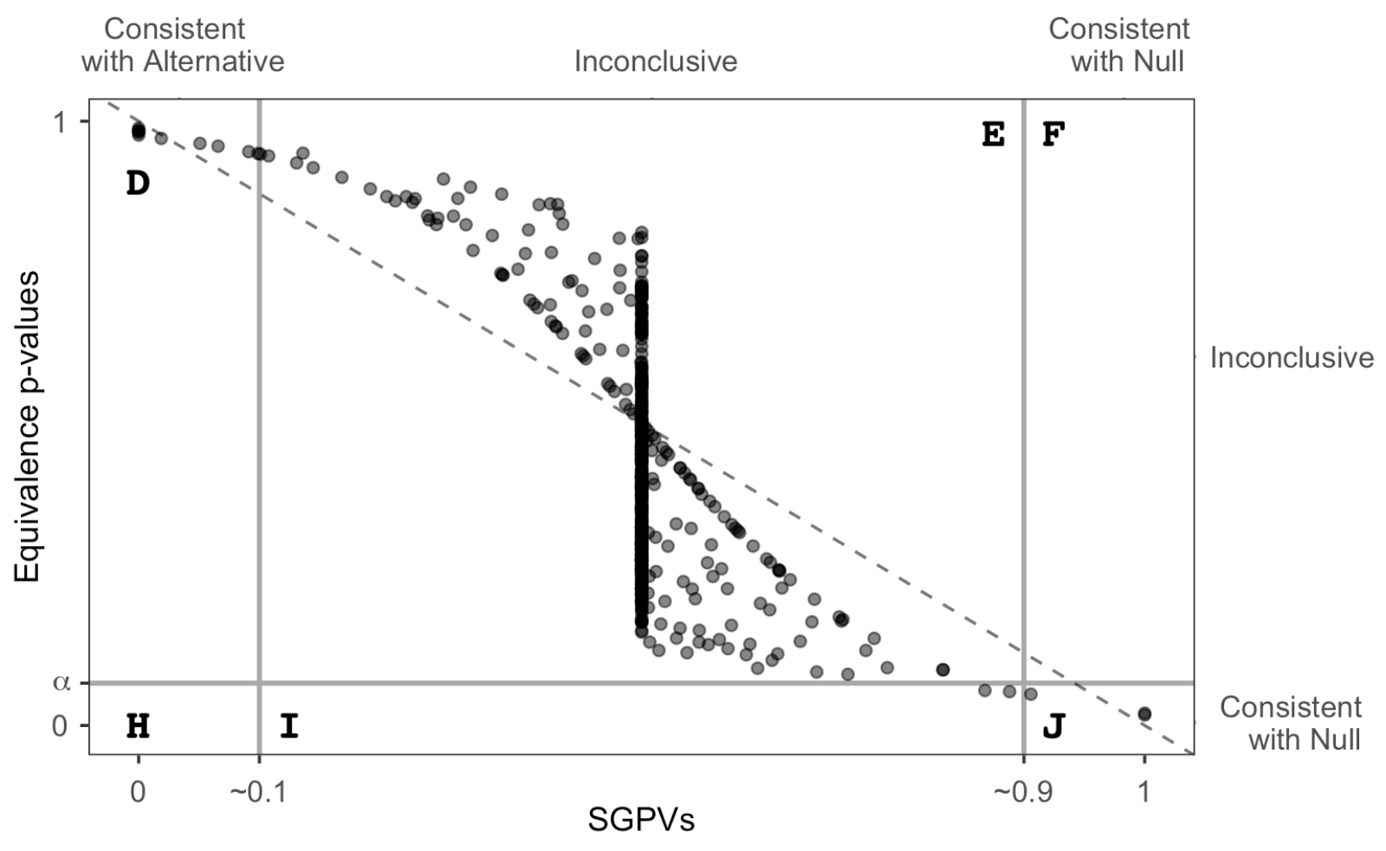
TOST vs. SGPV comparison

Slide 10
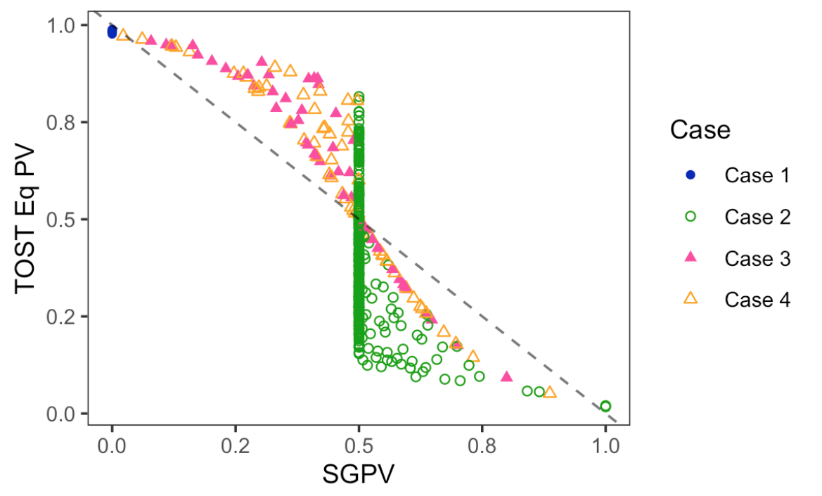
TOST vs. SGPV comparison

Slide 11
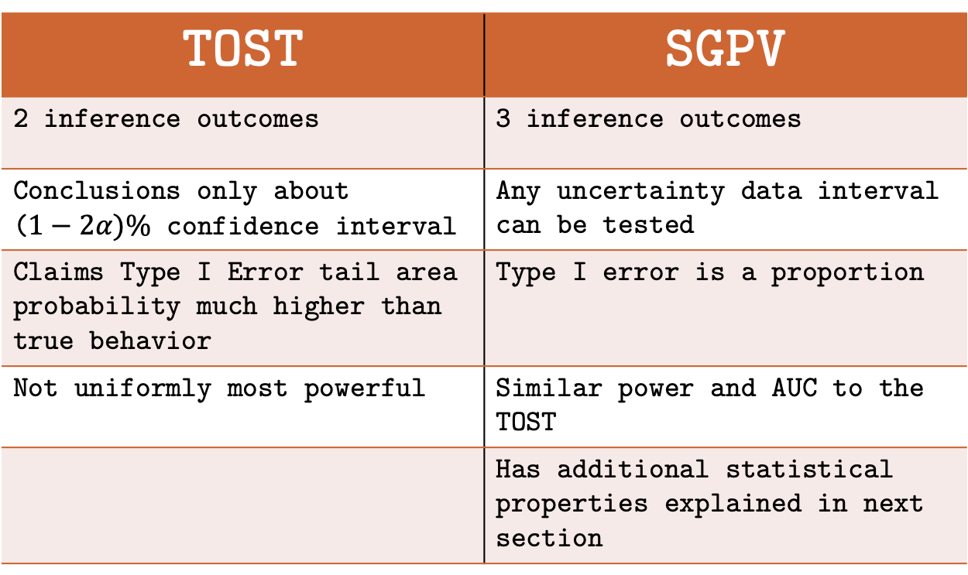
TOST vs. SGPV comparison
TOST | SGPV
2 inference outcomes | 3 inference outcomes
Conclusions only about ($1−2α)\%$ confidence interval | Any uncertainty data interval can be tested
Claims Type I Error tail area probability much higher than true behavior | Type I error is a proportion
Not uniformly most powerful | Similar power and AUC to the TOST
 | Has additional statistical properties explained in next section

Slide 12
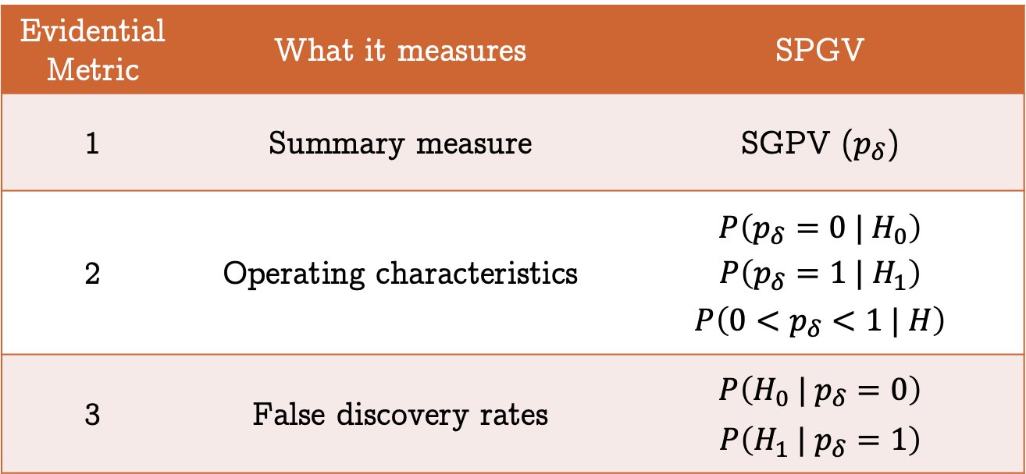
Second-generation p-value
Statistical properties in TAS & PLOS One
Retains strict error control
Evidential Metric | What it measures | SPGV
1 | Summary measure | SGPV ($p_{δ}$)
2 | Operating characteristics | $$P\left(p_{δ}=0 | H_{0}\right)$$ $$P\left(p_{δ}=1 | H_{1}\right)$$ $$P\left(0<p_{δ}<1 | H\right)$$
3 | False discovery rates | $$P\left(H_{0} | p_{δ}=0\right)$$ $$P\left(H_{1} | p_{δ}=1\right)$$

Slide 13
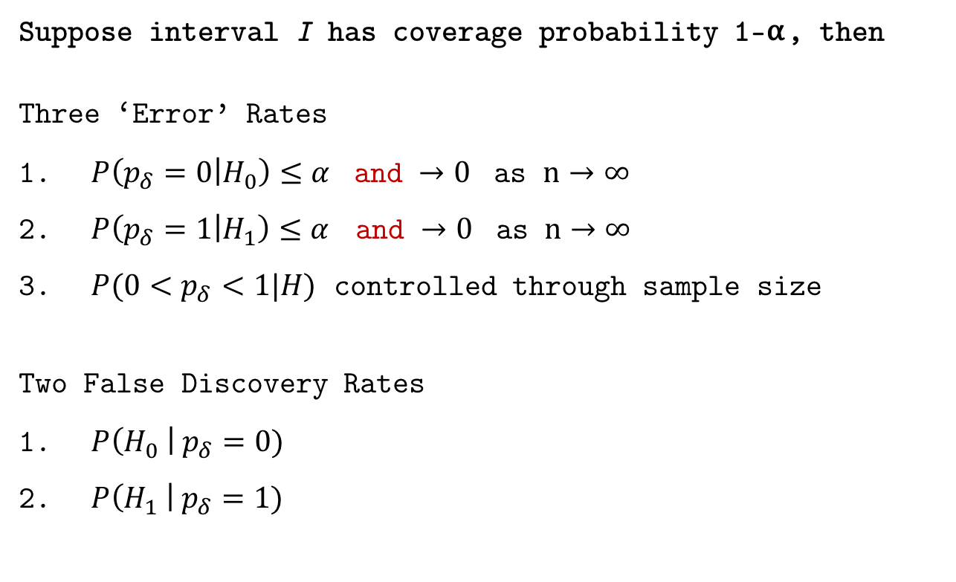
Statistical Properties
Suppose interval I has coverage probability 1-⍺, then
Three ‘Error’ Rates
$P\left(p_{δ}=0 | H_{0}\right)≤α$ and $→0$ as $n→∞$
$P\left(p_{δ}=1 | H_{1}\right)≤α$ and $→0$ as $n→∞$
$P(0<p_{δ}<1|H)$ controlled through sample size
Two False Discovery Rates
$P\left(H_{0} \right| p_{δ}=0)$
$P\left(H_{1} \right| p_{δ}=1)$
Will examine these first
Will graph to illustrate

Slide 14
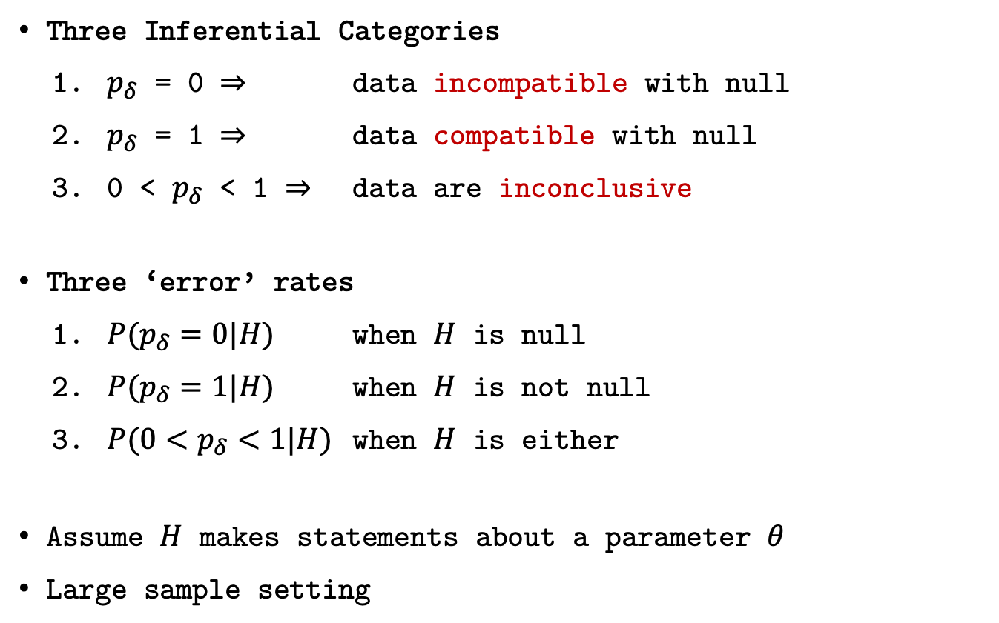
Statistical Properties
Three Inferential Categories
$p_{δ}$ = 0 $⇒$ data incompatible with null
$p_{δ}$ = 1 $⇒$ data compatible with null
0 < $p_{δ}$ < 1 $⇒$ data are inconclusive
Three ‘error’ rates
${P(p}_{δ}=0|H)$ when $H$ is null
${P(p}_{δ}=1|H)$ when $H$ is not null
${P(0<p}_{δ}<1|H)$ when $H$ is either
Assume $H$ makes statements about a parameter $θ$
Large sample setting

Slide 15
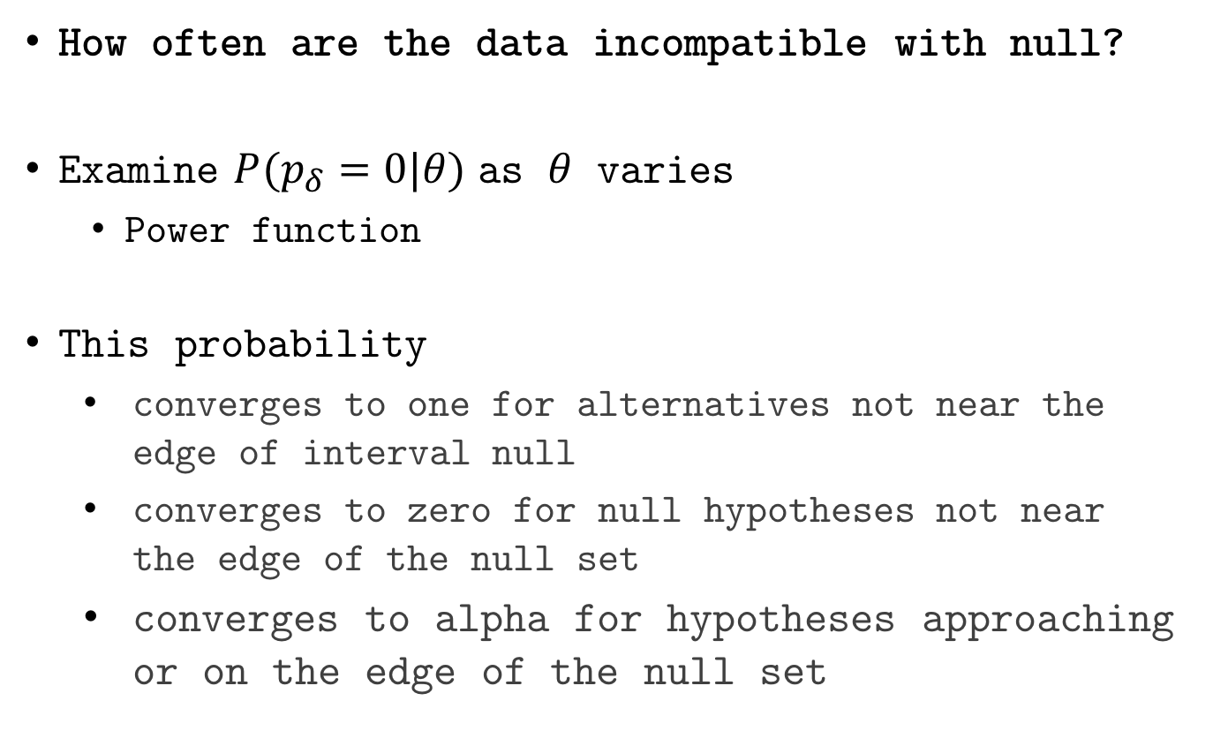
Statistical Properties
How often are the data incompatible with null?
Examine ${P(p}_{δ}=0|θ)$ as $θ$ varies
Power function
This probability
converges to one for alternatives not near the edge of interval null
converges to zero for null hypotheses not near the edge of the null set
converges to alpha for hypotheses approaching or on the edge of the null set

Slide 16
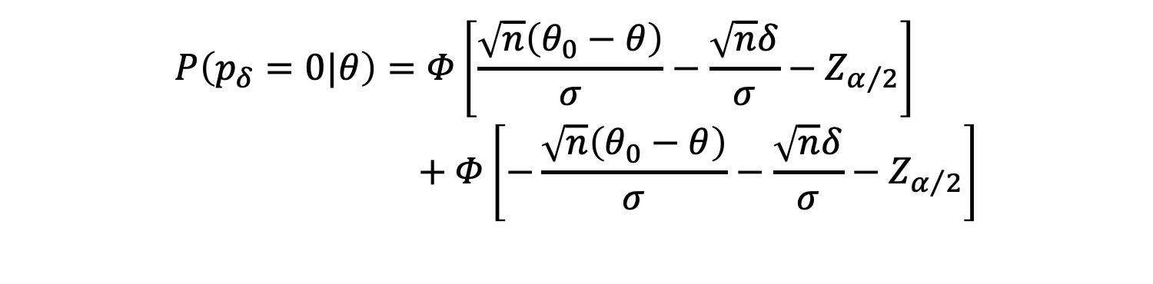
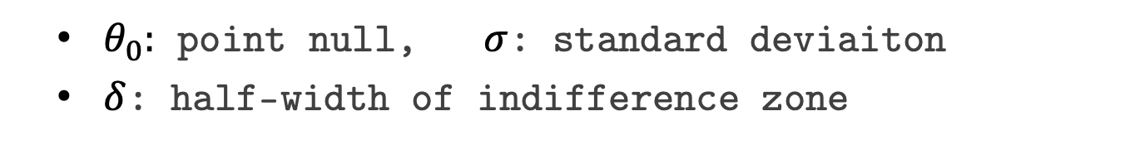
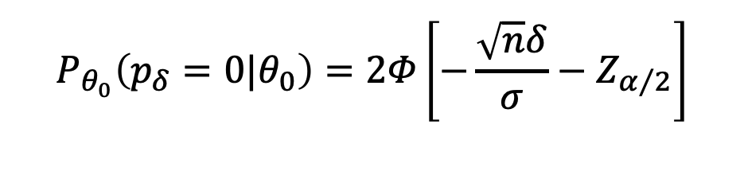
‘Power’ Function
$θ_{0}:$ point null, $σ$: standard deviaiton
$δ$: half-width of indifference zone
$$P\left(p_{δ}=0|θ\right)=Φ\left[\frac{\sqrt{n}\left(θ_{0}−θ\right)}{σ}−\frac{\sqrt{n}δ}{σ}−Z_{α/2}\right] \\ + Φ\left[−\frac{\sqrt{n}\left(θ_{0}−θ\right)}{σ}−\frac{\sqrt{n}δ}{σ}−Z_{α/2}\right]$$
$$P_{θ_{0}}\left(p_{δ}=0|θ_{0}\right)=2Φ\left[−\frac{\sqrt{n}δ}{σ}−Z_{α/2}\right]$$

Slide 17

$$P\left(p_{δ}=0|θ\right)$$

Slide 18
Compare with standard methods
Second-generation p-value vs. Bonferroni correction
Adjusted for {10, 100, 7128} comparisons
Leukemia data example
Remember SGPV are not adjusted for comparisons
Discuss?

Slide 22
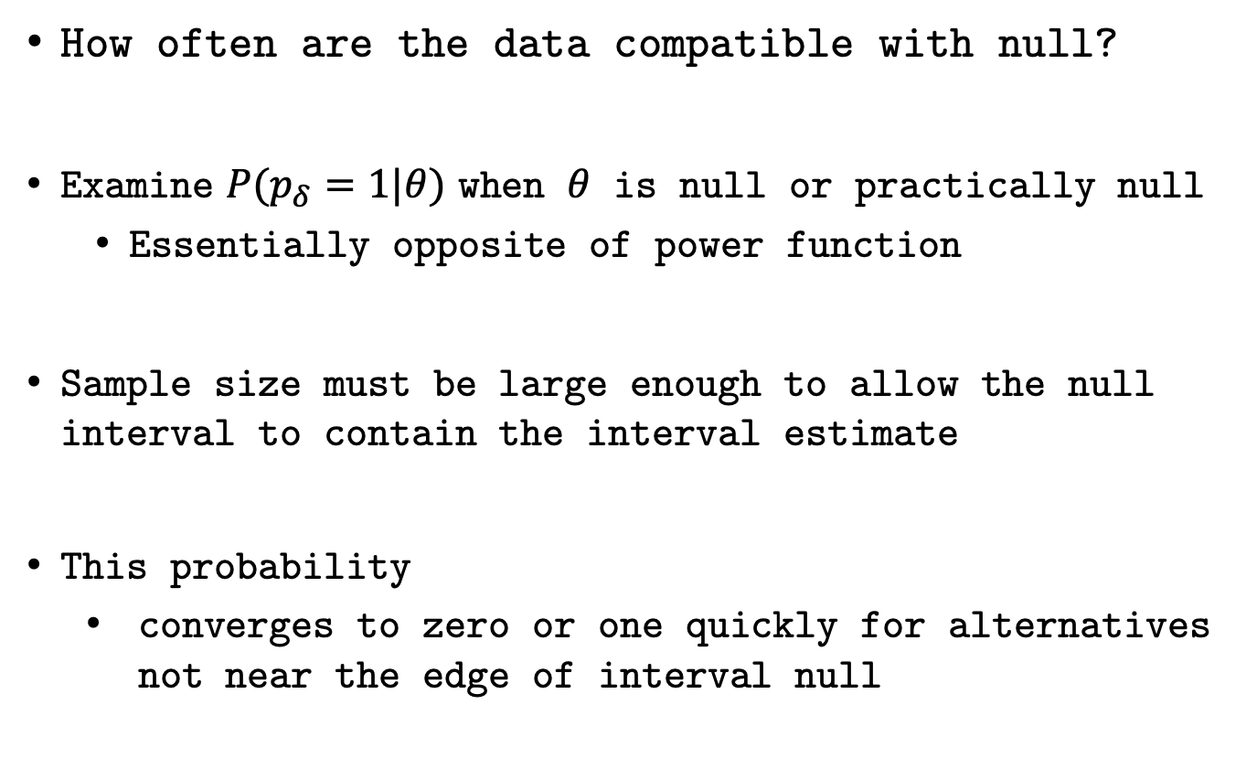
Compatible with Null
How often are the data compatible with null?
Examine ${P(p}_{δ}=1|θ)$ when $θ$ is null or practically null
Essentially opposite of power function
Sample size must be large enough to allow the null interval to contain the interval estimate
This probability
converges to zero or one quickly for alternatives not near the edge of interval null

Slide 23
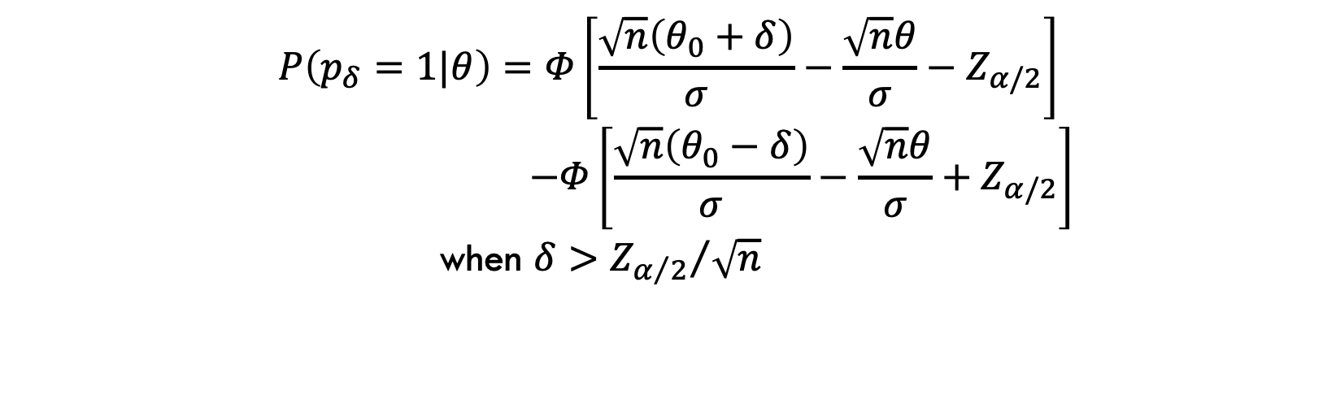
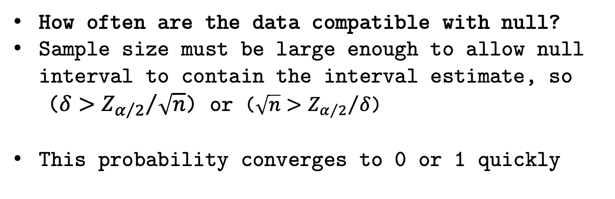
‘Null Power’ Function
How often are the data compatible with null?
Sample size must be large enough to allow null interval to contain the interval estimate, so
($δ>{Z_{α/2}}/{\sqrt{n}}$) or ($\sqrt{n}>{Z_{α/2}}/δ$)
This probability converges to 0 or 1 quickly
$$P\left(p_{δ}=1|θ\right)=Φ\left[\frac{\sqrt{n}\left(θ_{0}+δ\right)}{σ}−\frac{\sqrt{n}θ}{σ}−Z_{α/2}\right]$$
$$−Φ\left[\frac{\sqrt{n}\left(θ_{0}−δ\right)}{σ}−\frac{\sqrt{n}θ}{σ}+Z_{α/2}\right]$$
when $δ>{Z_{α/2}}/{\sqrt{n}}$

Slide 24

$$P\left(p_{δ}=1|θ\right)$$

Slide 25
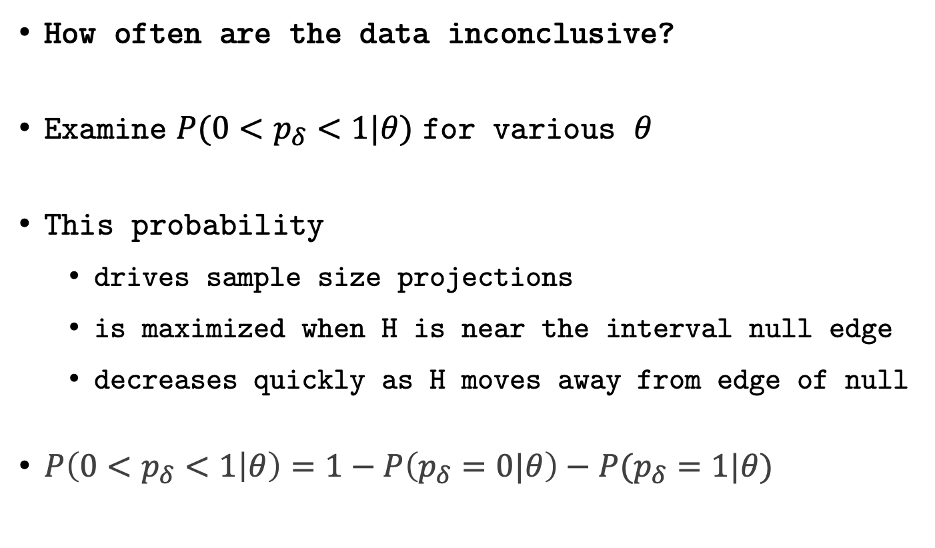
Probability of Inconclusive Data
How often are the data inconclusive?
Examine ${P(0<p}_{δ}<1|θ)$ for various $θ$
This probability
drives sample size projections
is maximized when H is near the interval null edge
decreases quickly as H moves away from edge of null
$P\left(0<p_{δ}<1 | θ\right)=1−P\left(p_{δ}=0|θ\right)−P(p_{δ}=1|θ)$

Slide 26
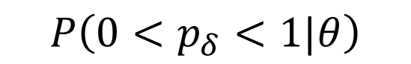
$$P\left(0<p_{δ}<1|θ\right)$$

Slide 27
$$P\left(0<p_{δ}<1|θ\right)$$

Slide 28
Statistical Properties
Suppose interval I has coverage probability 1-⍺, then
Three ‘Error’ Rates
$P\left(p_{δ}=0 | H_{0}\right)≤α$ and $→0$ as $n→∞$
$P\left(p_{δ}=1 | H_{1}\right)≤α$ and $→0$ as $n→∞$
$P(0<p_{δ}<1|H)$ controlled through sample size
Two False Discovery Rates
$P\left(H_{0} \right| p_{δ}=0)$
$P\left(H_{1} \right| p_{δ}=1)$

Slide 29
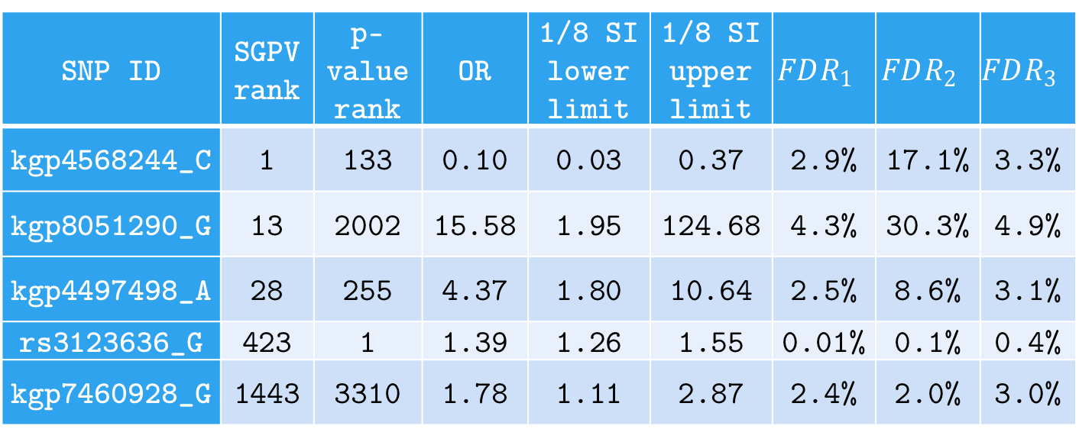
False Discovery Rates
FDR for 5 SGPV=0 findings; computed under various null and alternative configurations (w/ flat prior).
SNP ID | SGPV rank | p-value rank | OR | 1/8 SI lower limit | 1/8 SI upper limit | $$FDR_{1}$$ | $$FDR_{2}$$ | $$FDR_{3}$$
kgp4568244_C | 1 | 133 | 0.10 | 0.03 | 0.37 | 2.9% | 17.1% | 3.3%
kgp8051290_G | 13 | 2002 | 15.58 | 1.95 | 124.68 | 4.3% | 30.3% | 4.9%
kgp4497498_A | 28 | 255 | 4.37 | 1.80 | 10.64 | 2.5% | 8.6% | 3.1%
rs3123636_G | 423 | 1 | 1.39 | 1.26 | 1.55 | 0.01% | 0.1% | 0.4%
kgp7460928_G | 1443 | 3310 | 1.78 | 1.11 | 2.87 | 2.4% | 2.0% | 3.0%
Notes:
For illustration, we computed several flavors of the FDR for 5 SNPs with a SGPV of 0. These are displayed in Table 2. Three versions of the false discovery rate, $FDR=P\left(H_{0} | p_{δ}=0\right)$, were computed. Here $θ$ is the log odds ratio and $\hat{θ}$ is its MLE. $FDR_{1}$ uses the natural point null, $H_{0}:θ=\log\left(1\right)$ with the alternative set to the MLE, $H_{1}:θ=\hat{θ}$. $FDR_{2}$ uses a point null hypothesis that is closer to the null boundary, $H_{0}:θ=\log\left(1.05\right)$, with a prespecified alternative $H_{1}:θ=\log\left(2\right)$. $FDR_{3}$ uses the interval null $H_{0}:θ\sim unif\left[\log\left(0.9\right), \log\left(1/0.9\right)\right]$ and the interval alternative $H_{1}:θ\sim unif\left[{\hat{θ}}_{l},{\hat{θ}}_{u}\right]$ where ${\hat{θ}}_{l}$ and ${\hat{θ}}_{u}$ are the lower and upper bound of the 1/8 SI. FDR computations follow the formulae in Section 5 and Remark E.

Slide 30
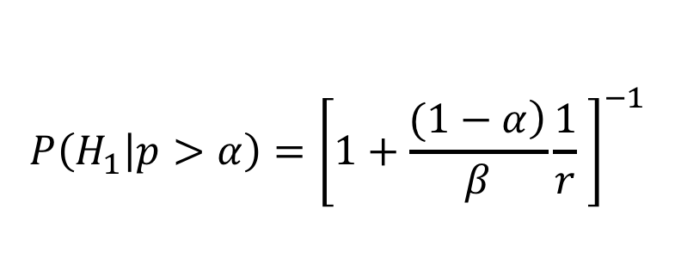
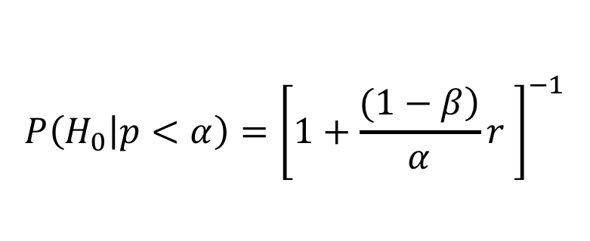
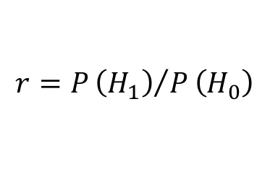
False discovery rates
Impact of ⍺=0.05 vs ⍺=0.05/7128 (7128 comparisons)
False Discovery Rate (FDR)
False Confirmation Rate (FCR)
Error rates
$$P\left(H_{0} | p<α\right)={\left[1+\frac{\left.(1−β\right)}{α}r \right]}^{−1}$$
$$P\left(H_{1} | p>α\right)={\left[1+\frac{\left.(1−α\right)}{β}\frac{1}{r} \right]}^{−1}$$
$$r=P{\left(H_{1}\right)}/P\left(H_{0}\right)$$
Error rates

Slide 31
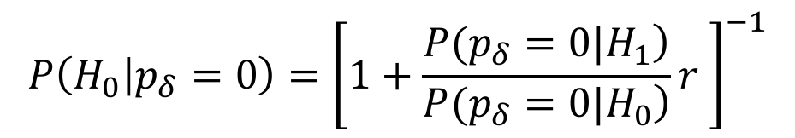
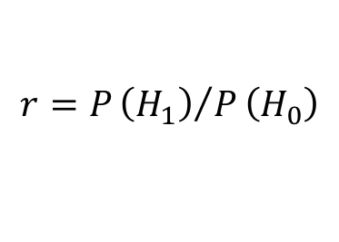
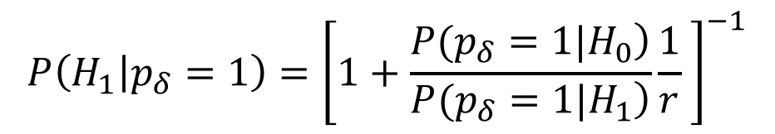
False discovery rates
Second-generation p-values
False Discovery Rate (FDR)
False Confirmation Rate (FCR)
Error Rates
$$P\left(H_{0} | p_{δ}=0\right)={\left[1+\frac{\left.P(p_{δ}=0|H_{1}\right)}{\left.P(p_{δ}=0|H_{0}\right)}r \right]}^{−1}$$
$$P\left(H_{1} | p_{δ}=1\right)={\left[1+\frac{\left.P(p_{δ}=1|H_{0}\right)}{\left.P(p_{δ}=1|H_{1}\right)}\frac{1}{r} \right]}^{−1}$$
$$r=P{\left(H_{1}\right)}/P\left(H_{0}\right)$$
Error Rates

Slide 32
r=1

Slide 33
r=1

Slide 34
r=1

Slide 35
r=1

Slide 36
r=1

Slide 37
r=1

Slide 38
r=1

Slide 39
FDR R Packages
SGPVs
sgpv::fdrisk()
This function computes the false discovery risk (sometimes called the "empirical bayes FDR") for a second-generation p-value of 0, or the false confirmation risk for a second-generation p-value of 1.
Raw p-values
FDRestimation::p.fdr()
This function computes FDRs and Method Adjusted p-values.
Methods include: Benjamini-Hochberg, Benjamini-Yeukateli, Bonferroni, Holm, Hochberg, and Sidak.

Slide 40
Remarks
Second-generation p-values…
Has three “Error” rates
Allows Type I and II rate to converge to zero
Control changes of inconclusive results
Controls error rate using science
Reduces the false discovery rate
Anchoring the scale of the effect size…
Eliminates most Type I Errors
Improves scientific translation of statistical model

Slide 41
Time for the Code Part II!

Slide 42
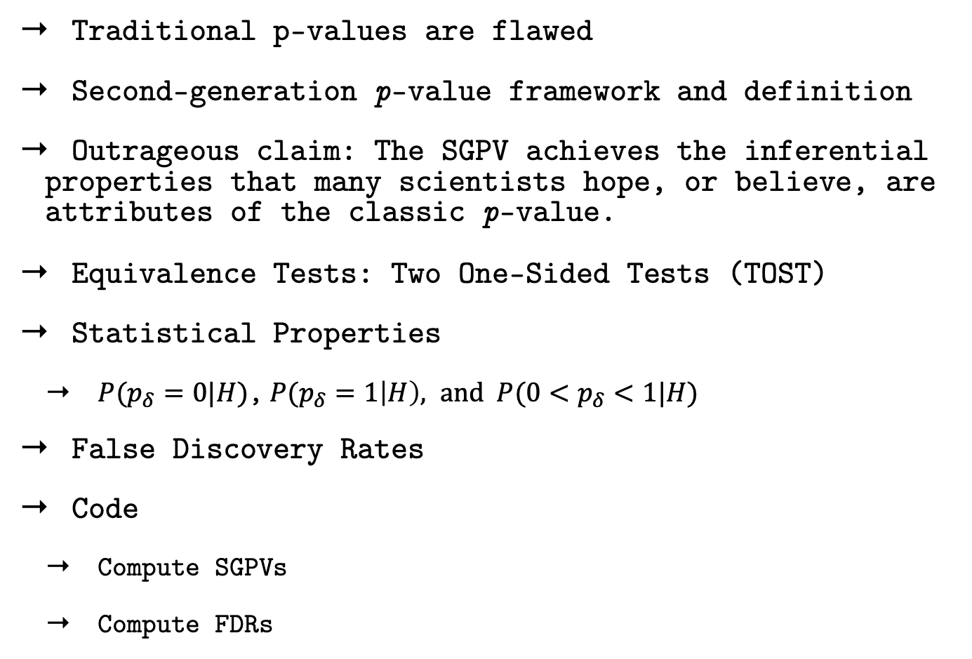
Review of Topics Learned
Traditional p-values are flawed
Second-generation p-value framework and definition
Outrageous claim: The SGPV achieves the inferential properties that many scientists hope, or believe, are attributes of the classic p-value.
Equivalence Tests: Two One-Sided Tests (TOST)
Statistical Properties
${P(p}_{δ}=0|H)$,${P(p}_{δ}=1\left|H\right), and {P(0<p}_{δ}<1|H)$
False Discovery Rates
Code
Compute SGPVs
Compute FDRs

Slide 43
Things we couldn’t get to:
SGPV variable selection by Yi Zuo
R Package: ProSGPV
Regression modeling
Adjust for collaborator uncertainty when choosing the null zone
Shrink null zone as sample size increases

Slide 44
Acknowledgements
Collaborators
William D. Dupont
Robert A. Greevy
Lucy D’Agostino McGowan
Valerie Welty
Jeffrey R. Smith
Yi Zuo
Thomas G. Stewart
Vanderbilt SEDS Lab
Website
www.statisticalevidence.com

